Slide 1


Price Model
Presented by :
Maarten Van den Bulcke
Leonor Drummond
Hoang Minh Nguyen
Jacques Declercq

Slide 2
Table of Content
Immo-Eliza - Price Model
Goal & Project Summary
Data Analysis
Data Cleaning
Data Interpretations
Data Visualizations
Conclusion

Slide 3





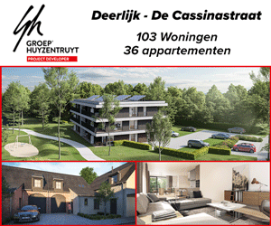
Goal : Create a machine learning model to predict prices on Belgium’s property sales.

Slide 4

Project Summary
+ 10k properties data Set.
Clean and organise the data.
Find variables influencing prices.
Interpret the data for market insights.
Visualise the data with graphics.

Slide 5
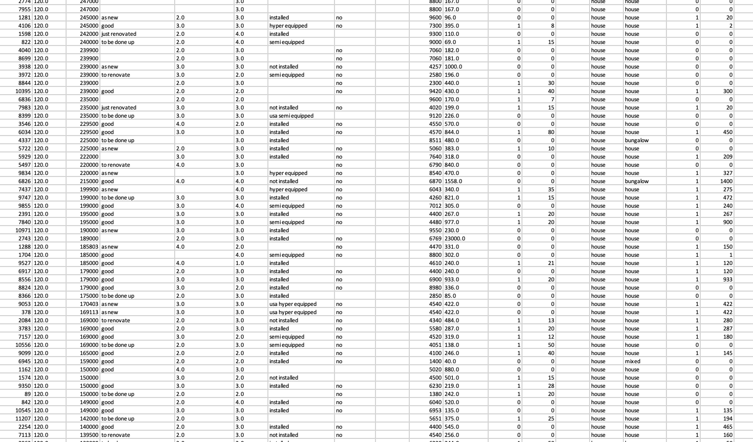
Data Analysis
GOAL :
Create a machine learning model to predict prices on Belgium’s property sales.
Clean the data : Remove rows with missing values and outliers* (ex. area & price)
Modify the data so its visualisable (ex. state of property open-fire)
Add to the data for better insights. (ex. region, province, cities)
*For the price model we based us on the largest sample in the dataset : properties worth < €750.000

Slide 6


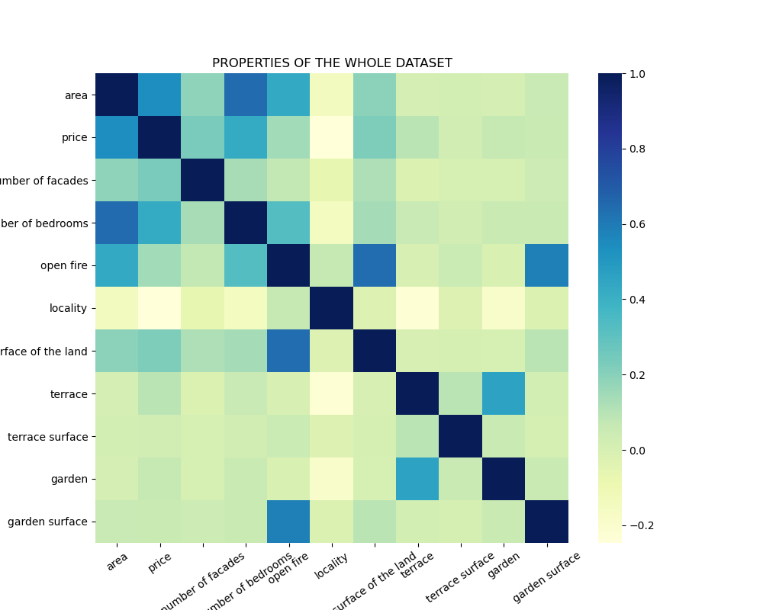
Price co-relations
Important numeric features : area (m2), number of bedrooms

Slide 7
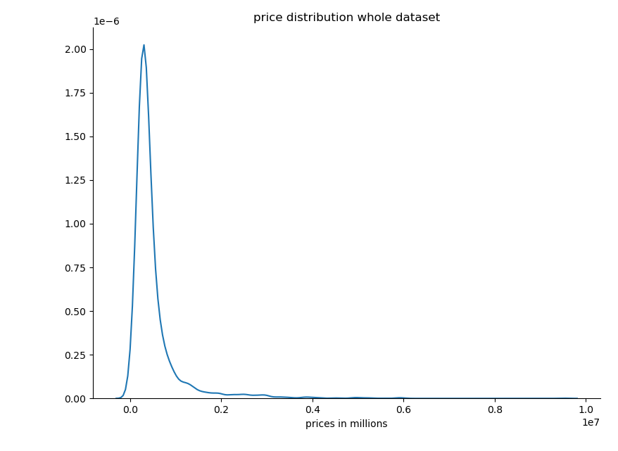
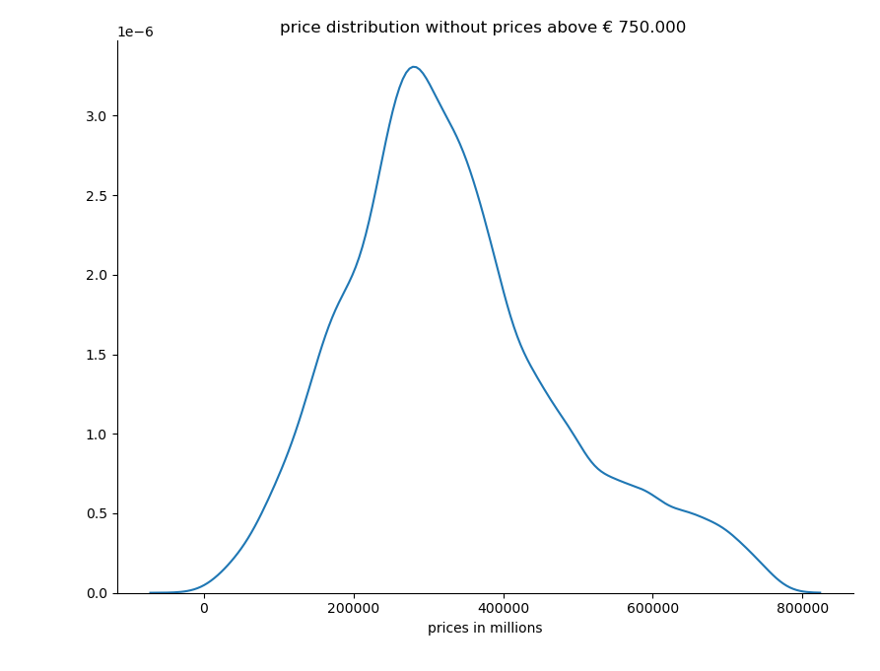
Price co-relations
Better for the ML price model (linear graph for supervised learning)

Slide 8
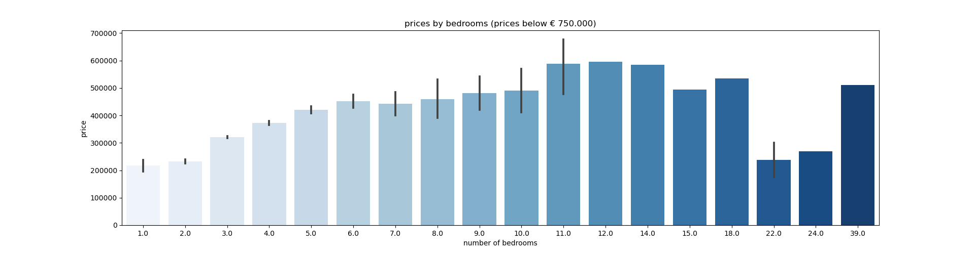


Price of property per nr of bedroom
Price.
Most expensive property has 11 bedrooms.
Interesting
At 11 bedrooms the price starts to stagnate.

Slide 9
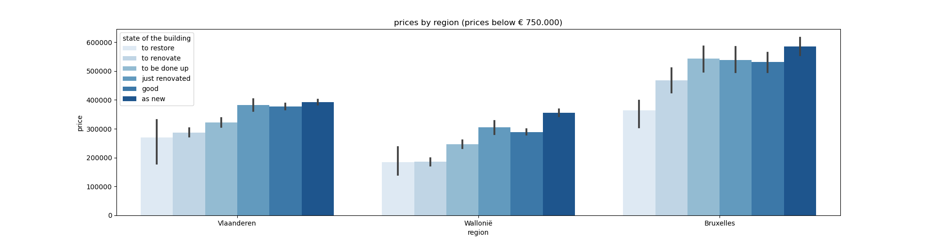

Price per region per state of property
Price.
Properties as new are the most expensive. Followed by just renovated.
Province
Brussels most expensive, Wallonia is the cheapest
Interesting
A to restore property in Brussels is as expensive as a new property in Wallonië

Slide 10
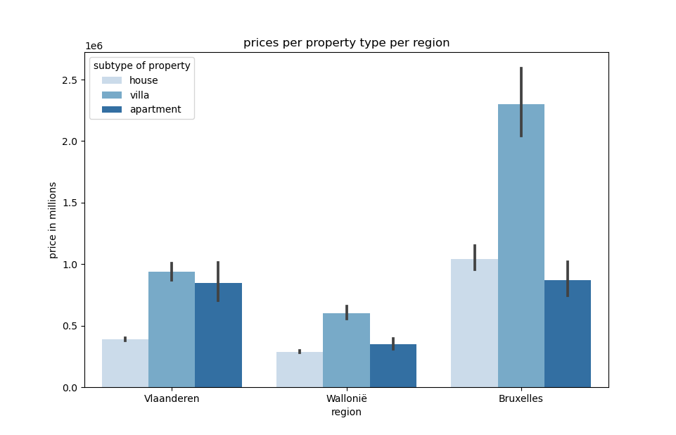
Price per subtype per region
Price
A Villa in Bruxelles is the most expensive property. 2nd to a house in the same region and followed by a villa in Vlaanderen.
Interesting
A villa is almost double the price of a house in any region.

Slide 11
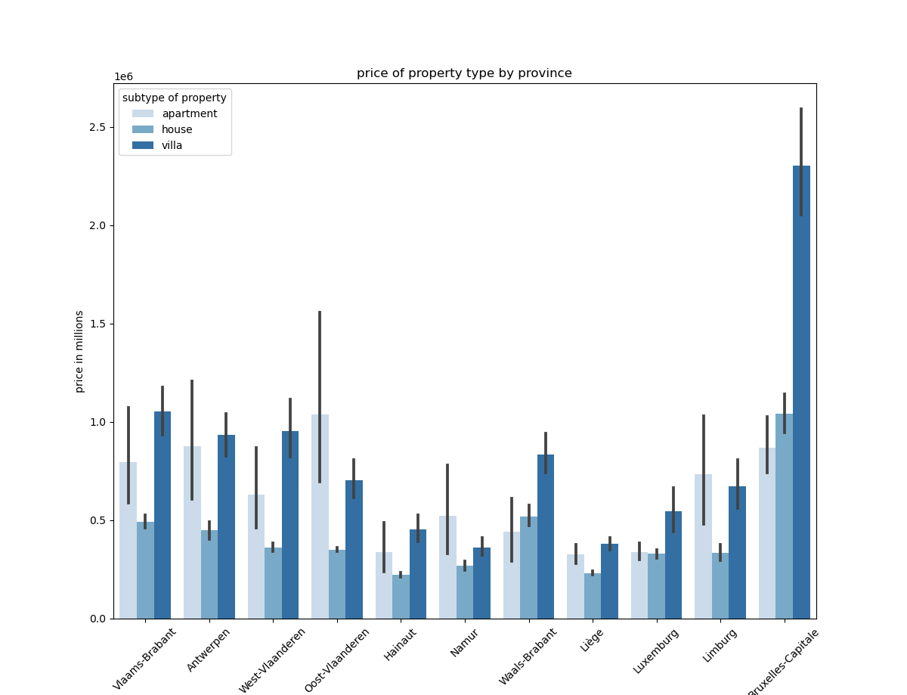
Price per subtype per province
Interesting
The most expensive apartment is in Oost-Vlaanderen.
The cheapest to buy is in Liege

Slide 12
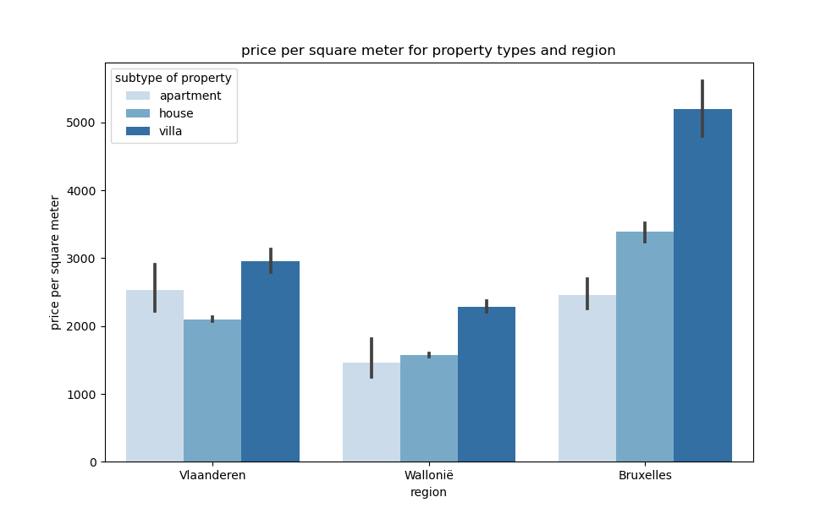
Price per m2
Price
Brussels tops for price per m2 with +€5000.
Province
Brussels most expensive, Wallonia is the cheapest.
Interesting
As seen before the most expensive apartment
are in Vlaanderen.

Slide 13
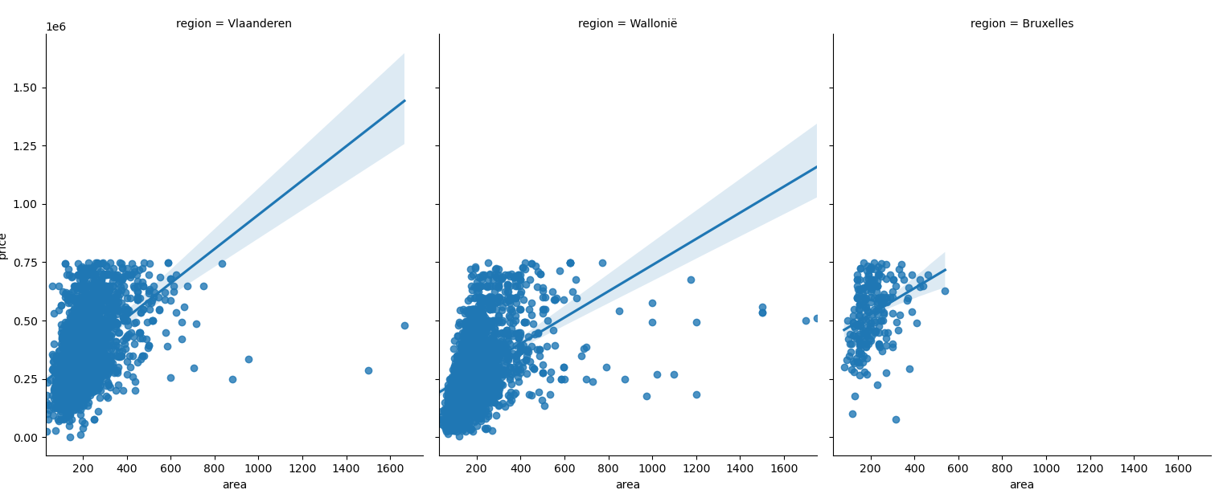
Price per area (m2) per region
Price
Op een schaal van 1 (i.e. de groep met de meeste koopkracht) tot 8
(met de minste), zien we niet meteen grote verschillen in respons op deze content.
Interesting
Wallonië properties have more m2
Province
Bruxelles starts at a higher price and has less outliers

Slide 14
Conclusions
Price, area, nr of bedrooms, state of the building and location is very price influencing.
Brussels is the most expensive region & Wallonië is the cheapest.
Apartments mosst expensive in Oost-Vlaanderen
For the price model it would be more suitable to use price/m2 than area. (supervised learning)

Slide 15
THANK YOU

